Slide 1

Hardware Implementation of Finite State Machines for Embedded Systems
Presented by
C.santhosh(192011045)
B.Sumanth (192011027)
DK

Slide 2
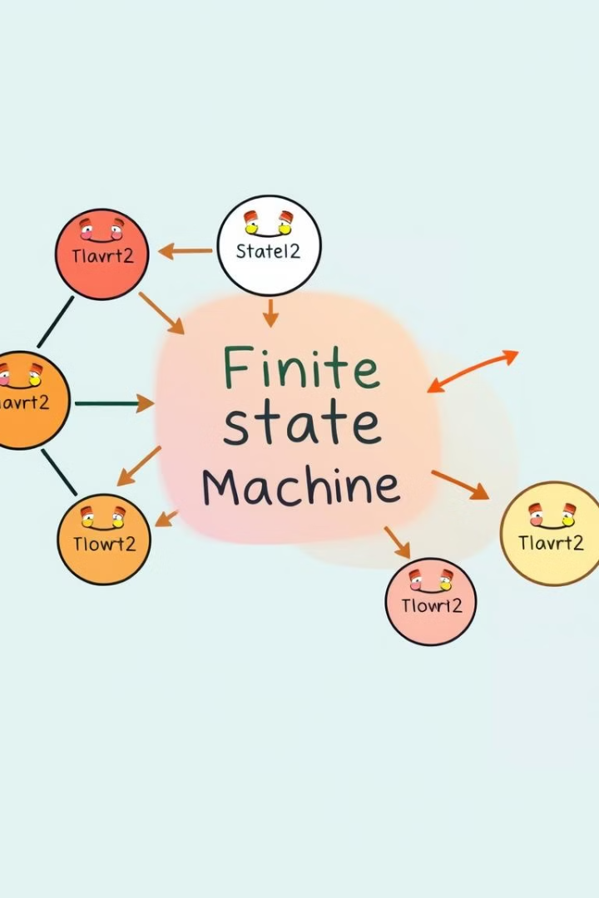
Introduction to Finite State Machines (FSMs)
1
Discrete States
2
Transitions
FSMs are mathematical models that represent a system's behavior as a finite number of discrete states.
Transitions between states are triggered by input conditions, allowing the machine to respond to different scenarios.
3
Sequential Logic
FSMs are well-suited for designing sequential logic circuits, where the output depends on the current state and input.

Slide 3
Understanding Finite State Machines
Formal Definition
Mealy and Moore Models
Modeling Techniques
An FSM is formally defined as a 5-tuple: (Q, Σ, δ, q0, F), where Q is the set of states, Σ is the input alphabet, δ is the transition function, q0 is the initial state, and F is the set of final states.
FSMs can be classified into Mealy and Moore models, which differ in the way they generate outputs based on the current state and inputs.
FSMs can be modeled using state diagrams, state tables, and other mathematical representations, depending on the complexity of the system.

Slide 4
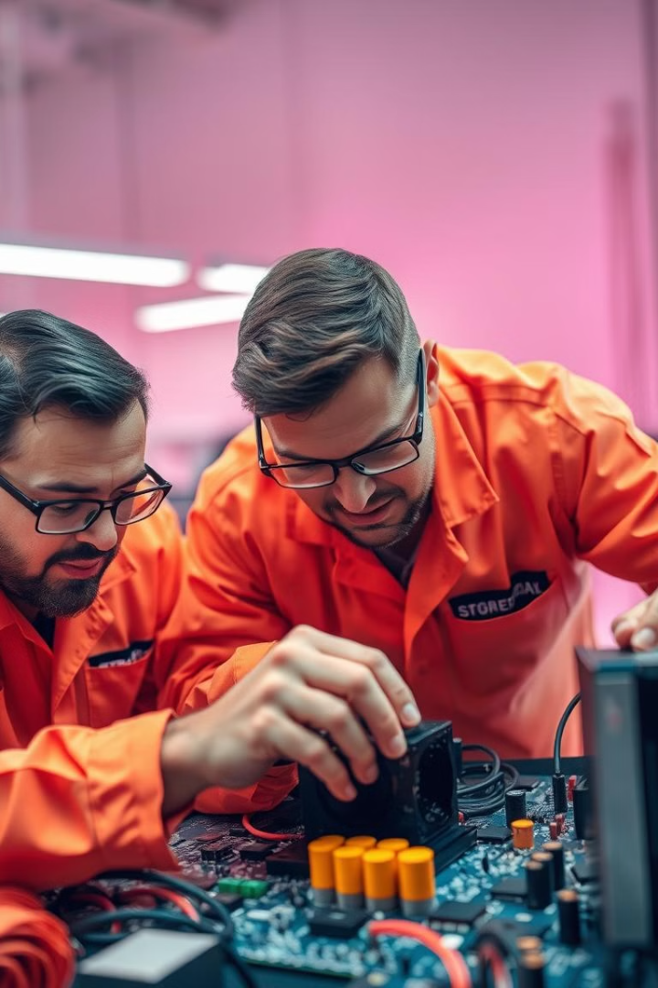
The Role of Finite State Machines
Control Systems
Communication Protocols
FSMs are widely used in control systems, such as those found in home appliances, industrial machinery, and automotive electronics.
FSMs are crucial in designing and implementing communication protocols, where they manage the flow of data and control the state of the connection.
Digital Logic Design
Embedded Systems
FSMs are fundamental building blocks in digital logic design, enabling the creation of complex sequential circuits and state-based systems.
The hardware implementation of FSMs is particularly important in embedded systems, where they provide efficient and reliable control mechanisms.

Slide 5
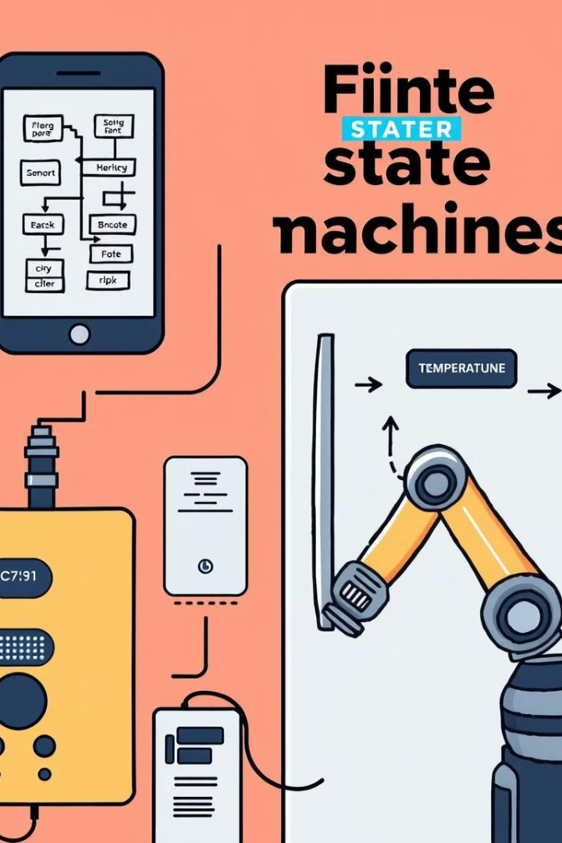

Real-World Applications of Finite State Machines
Traffic Signals
Elevator Control
FSMs control the sequence of traffic lights, ensuring the safe and efficient flow of vehicles and pedestrians.
FSMs manage the operation of elevators, handling floor selection, door opening and closing, and safety features.
Washing Machines
Processor Design
FSMs govern the various cycles and operations of washing machines, ensuring the proper sequence of water intake, agitation, and spin cycles.
FSMs are integral to the design of computer processors, managing the flow of instructions and data through the various stages of execution.

Slide 6




Conclusion and Future Trends
Increased Complexity
As embedded systems become more sophisticated, the complexity of FSMs will continue to grow, necessitating advanced design and verification techniques.
Hardware Optimization
The hardware implementation of FSMs will focus on optimizing performance, power consumption, and resource utilization, leveraging emerging technologies and design methodologies.
Adaptive Algorithms
The integration of machine learning and artificial intelligence will enable the development of adaptive FSMs that can dynamically adjust their behavior based on environmental conditions and evolving requirements.

Slide 7
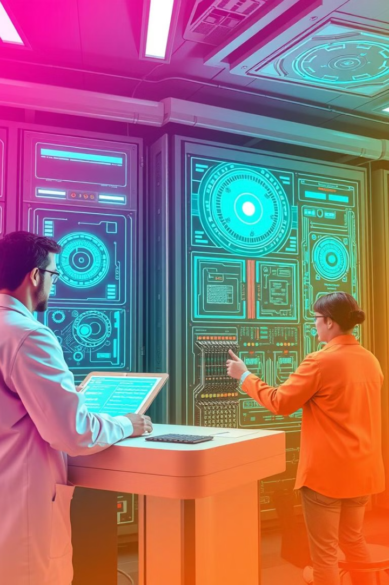
Looking Ahead: The Future of Finite State Machines
1
Quantum Computing
Advances in quantum computing may lead to the development of novel FSM architectures that can leverage quantum phenomena for increased speed and efficiency.
2
Neuromorphic Design
The integration of neuromorphic computing principles into FSM design could result in more adaptable and autonomous systems, capable of learning and evolving over time.
3
Internet of Things
As the IoT ecosystem expands, the need for efficient and scalable FSM-based controllers will grow, enabling the seamless management of interconnected devices and systems.

